Slide 1
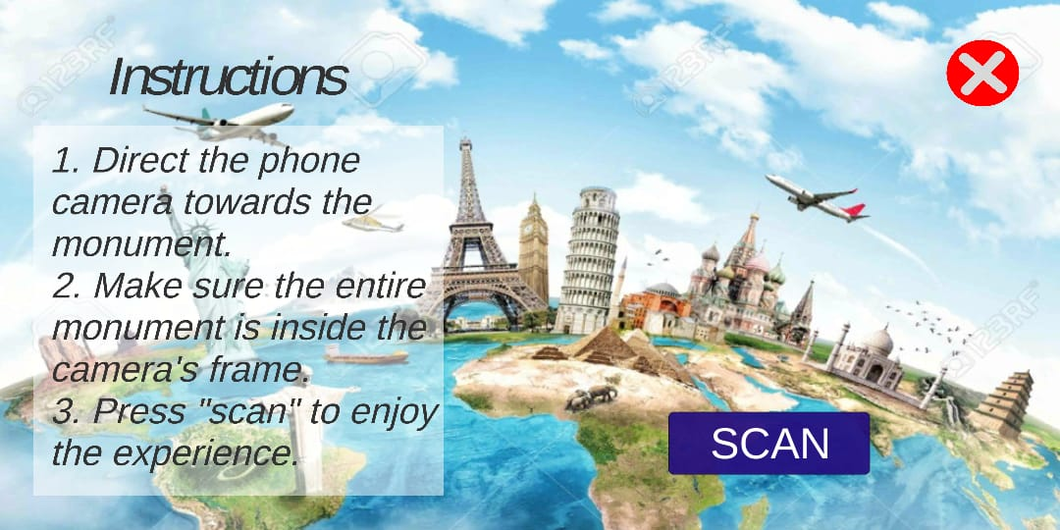
How does this work?
Once the user installs our android application on his/her phone, all he has to do is to open the app and press the SCAN button.
The home page of our application

Slide 2
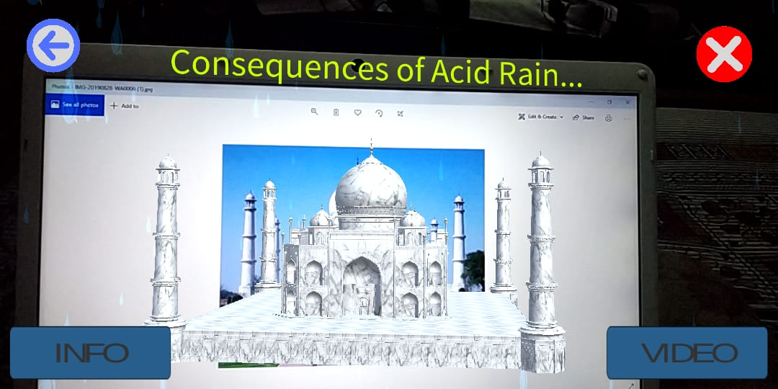
As soon as he does that, the mobile camera opens and the user has to scan the monument/building in front. (We have taken an image for now but the app will work the same with real monument as well or even better)
The augmented version of Taj Mahal is overlaid

Slide 3
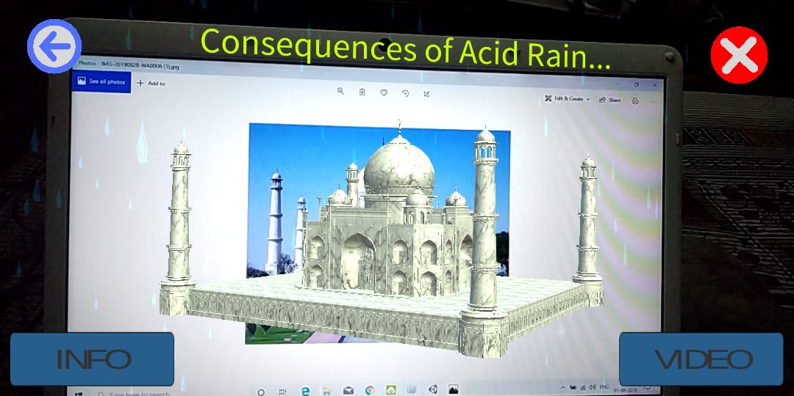
Once the building is detected, a beautiful augmented 3-D model of the same is overlaid with relevant animations and an important message.
The rotating Taj Mahal with an important message, (white marble turning yellow)

Slide 4
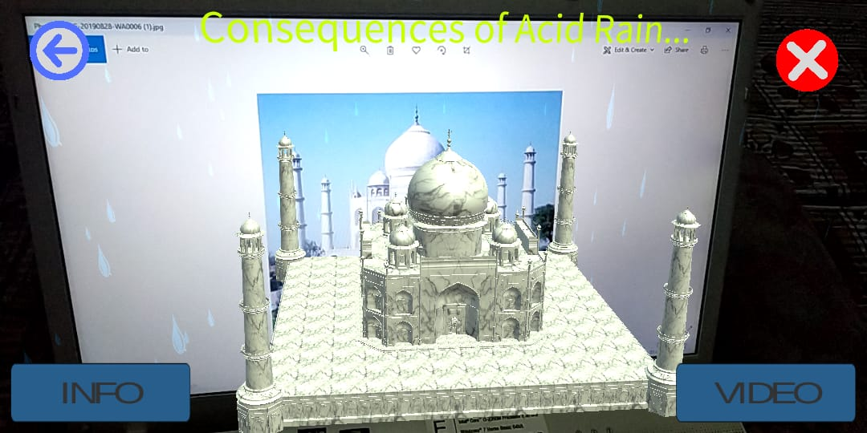
The user also has the option to explore more about the monument, by pressing the info button which gives the user a brief monument tour and a video button which shows a mesmerizing video associated with the monument.
Various UI buttons like “INFO”, “VIDEO”, “BACK” and “CROSS”

Slide 5
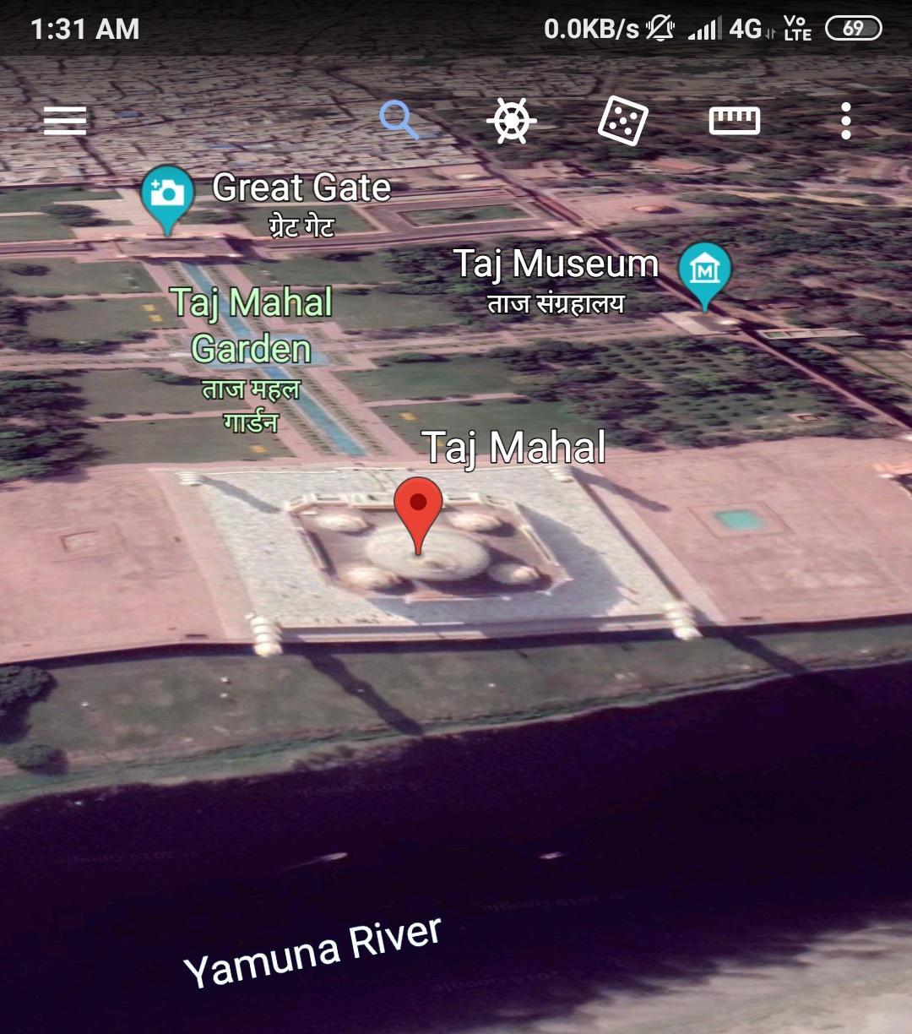
What’s Different??
Although Google Earth has implemented 3-D modeling of real world structures but when you actually visit the app, the 3-D structures of Indian monuments are missing.
Our app focuses especially on Indian monuments.
No 3-D model being displayed.

Slide 6

How was it built?
We designed this app with the help of UNITY software. We built various scenes for different stages of application.

Slide 7

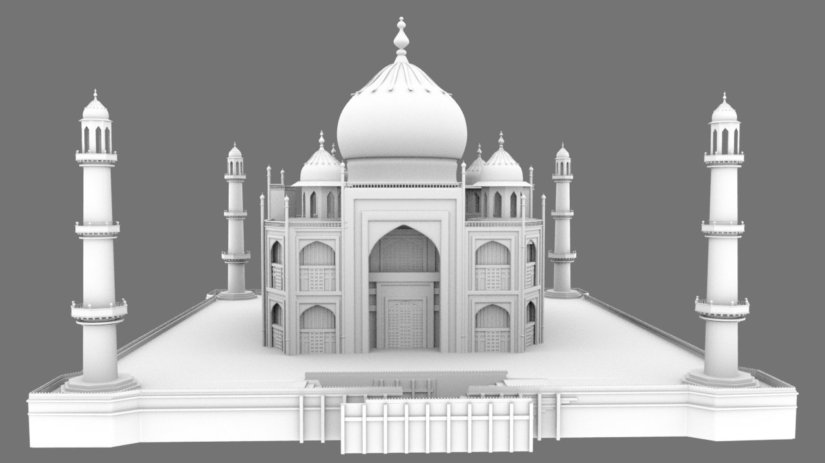
The database for image target was made with the help of Vuforia and was then imported in UNITY.
The model of Taj Mahal was then made in UNITY to which we added various effects and transformations.

Slide 8

An instruction as well as various UI buttons were created to help the user navigate through the app.
Once the app was ready, we built the apk with the help of Android SDK manager.

